Slide 1
An Introduction to Insights Discovery

Slide 2
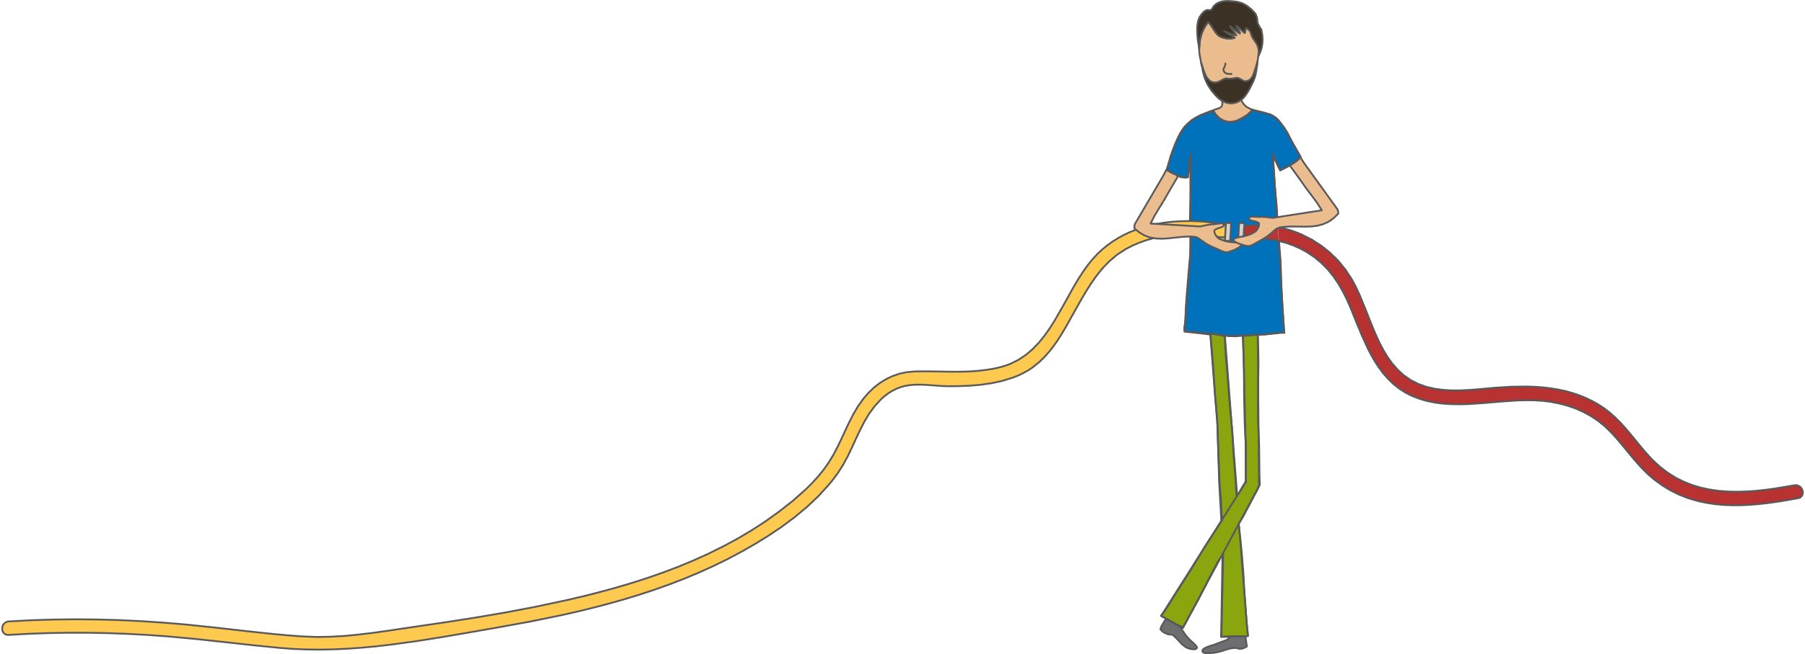
Learning Intentions
Understand Yourself: what is it about you, that’s unique?
Understand Others: explore and understand the diversity in your team
Adapt and Connect: understand how to use this information to create better working relationships
Team Charter: Develop our ways of working together moving forward

Slide 3
Learning Intentions
Understand Yourself: what is it about you, that’s unique?
Understand Others: explore and understand the diversity in your team
Understand Team: High Performing Functional team
Adapt and Connect: understand how to use this information to create better working relationships

Slide 4
Learning Intentions
Understand Yourself: what is it about you, that’s unique?
Understand Others: explore and understand the diversity in your team
Adapt and Connect: understand how to use this information to create better working relationships

Slide 5
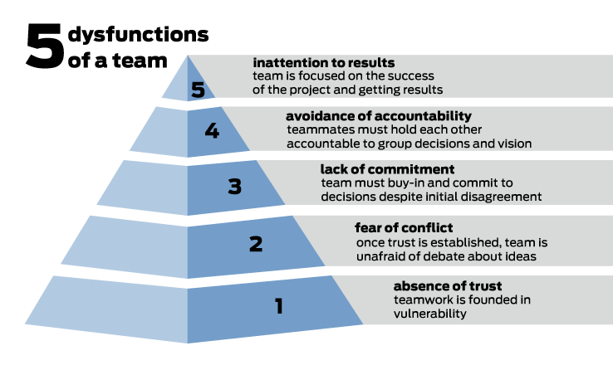

Slide 6
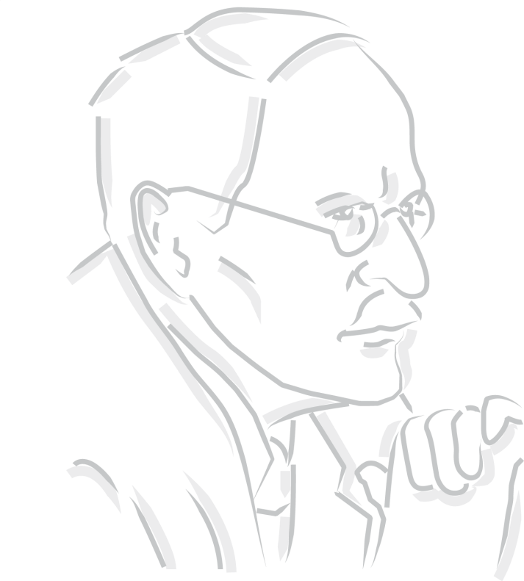
“Wisdom accepts that all things have two sides.”
Carl Jung

Slide 7

Who are you?
Where are you?
What you do?
Introductions

Slide 8
Who are you?
What you do?
Introductions

Slide 9
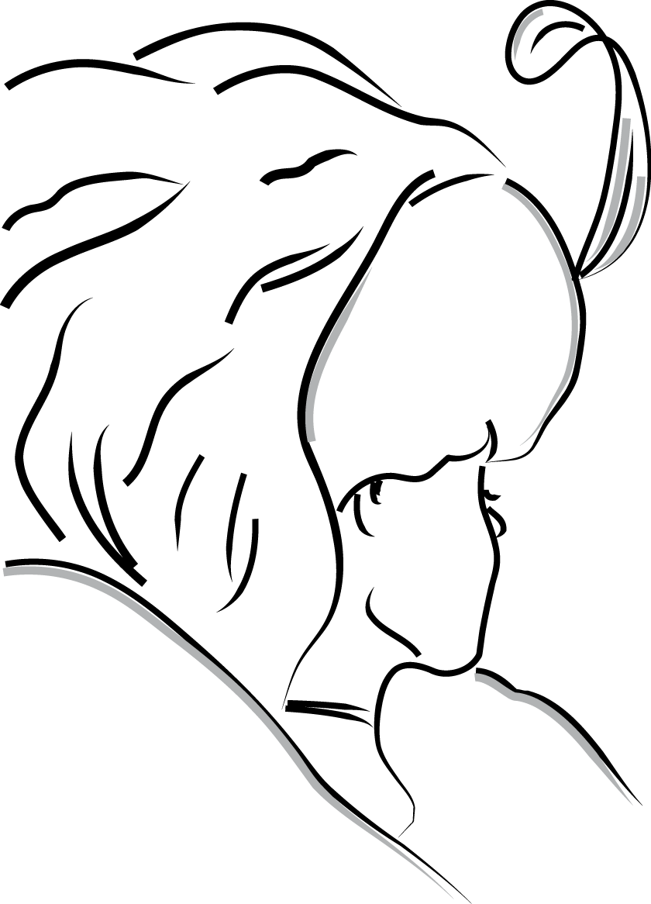
Perception
You will see the world differently from the way other people see it.
Notes:
What do you see here?

Slide 10
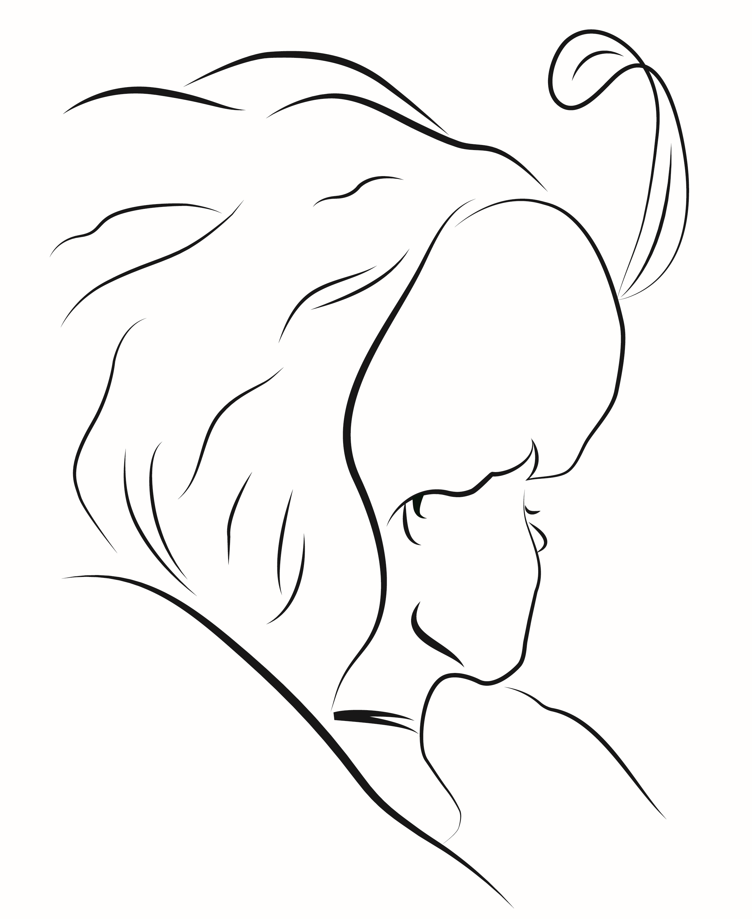
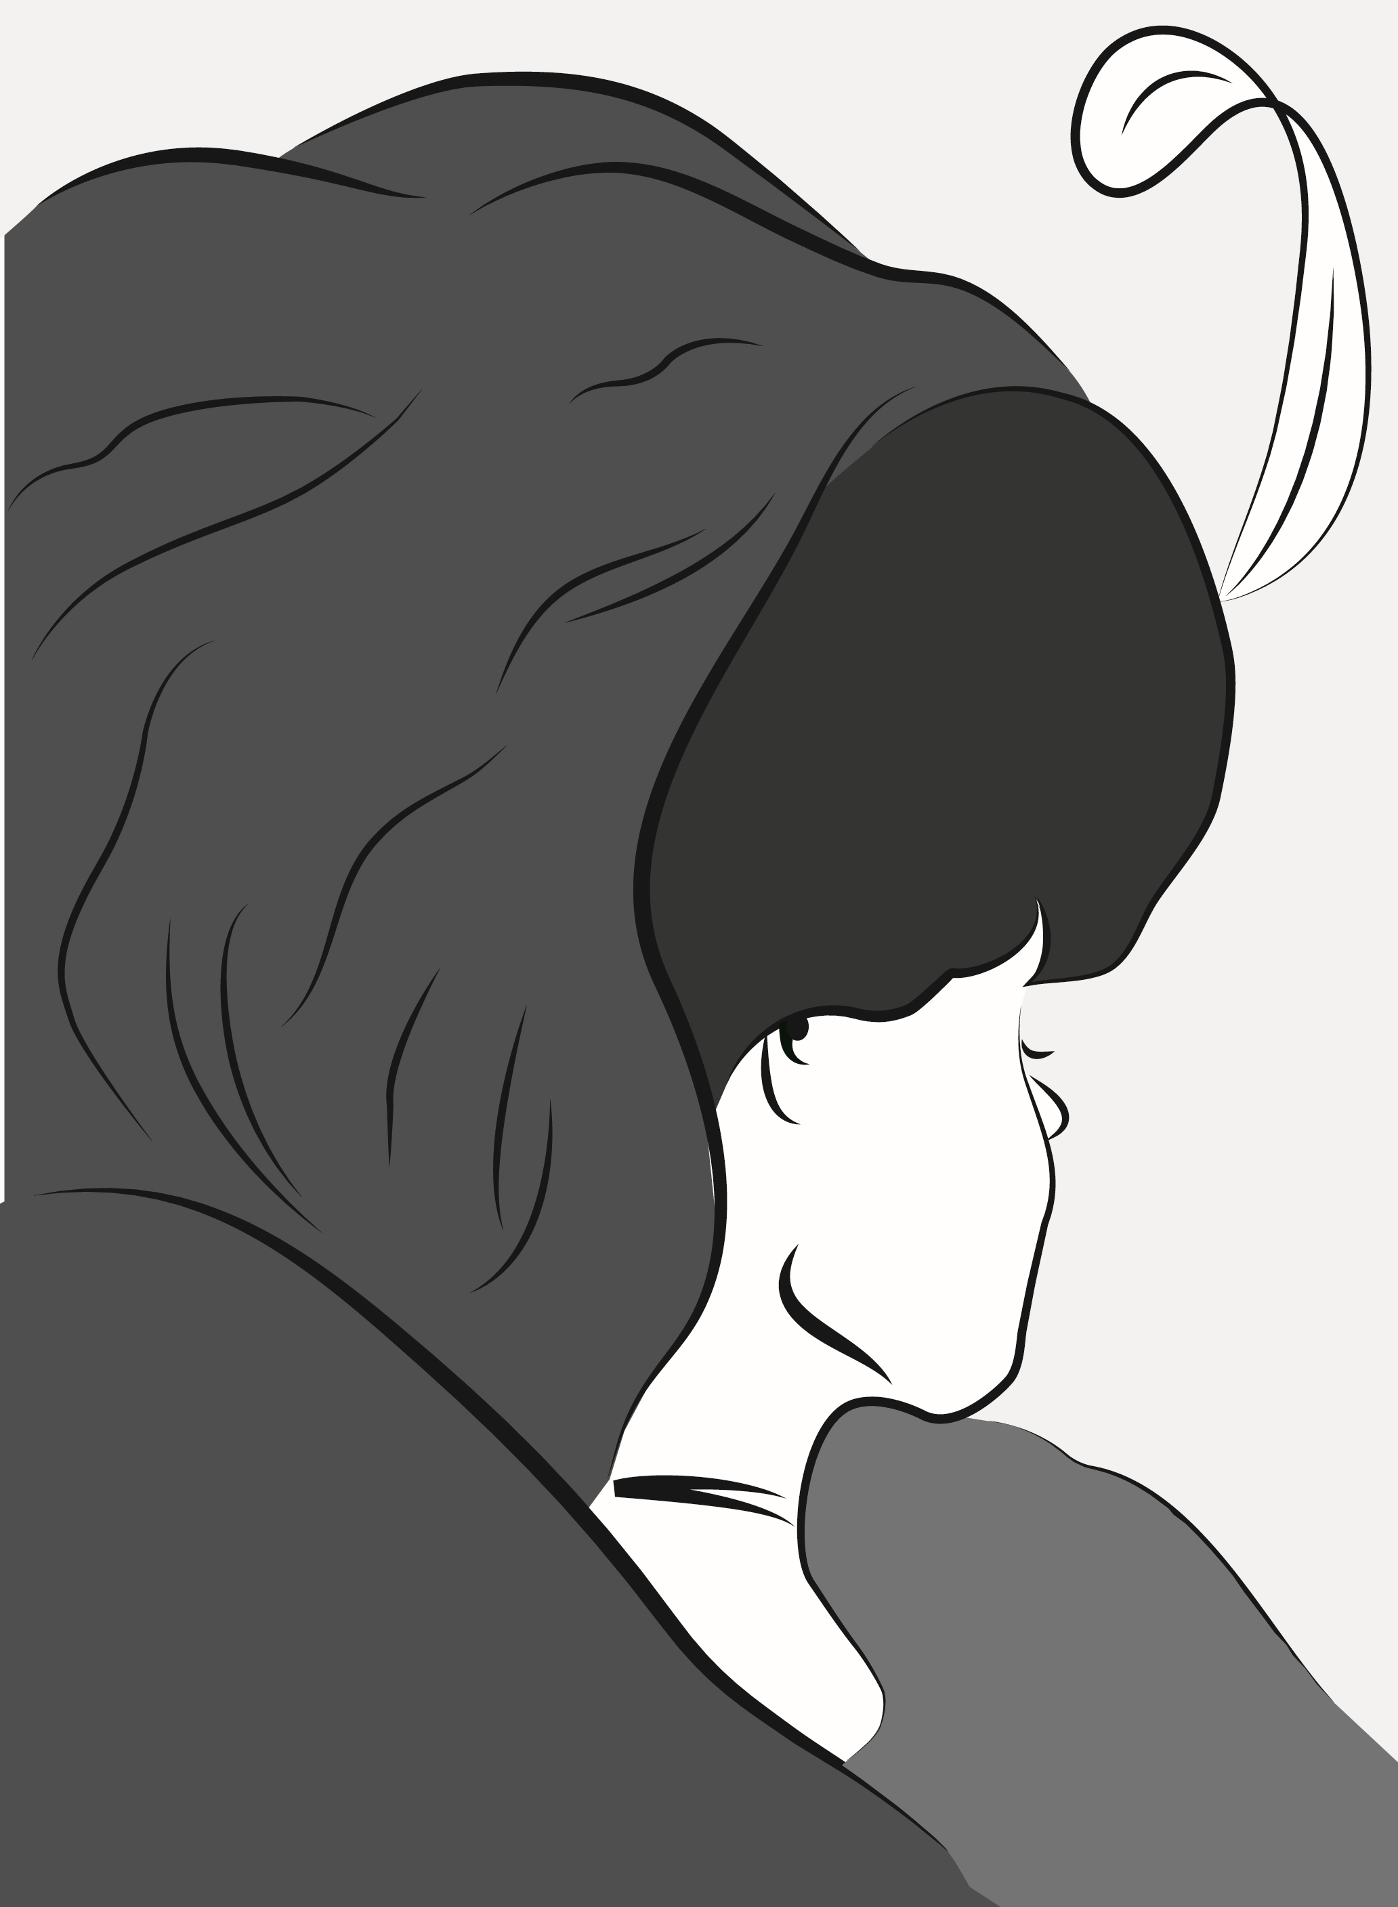

Slide 11
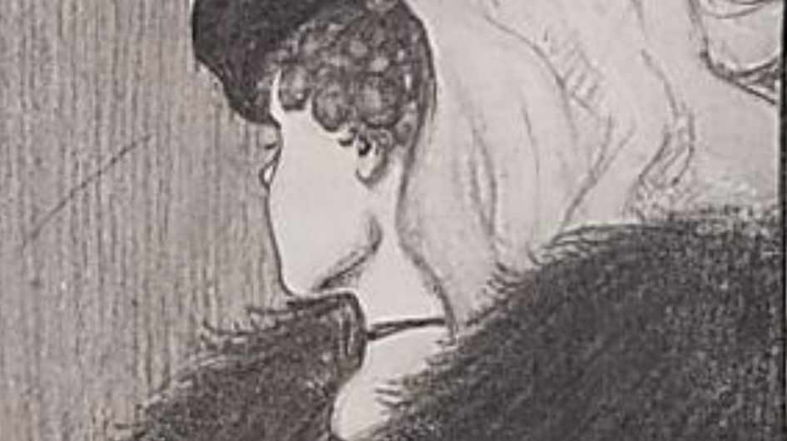

Slide 12
Perception scenario
You have new team member who you have spent a lot of time with over the last few days as they have started work. You have just passed this person in the hallway. They walked by you without looking up or saying hello.
What are your immediate thoughts and feelings?
What's wrong:
Why didn’t they talk to me, are they ok?
Forgotten:
All that time I spent with them and they have forgotten me
Not bothered:
I didn’t pay them much attention anyway
Busy:
They are obviously busy, that’s their business

Slide 13
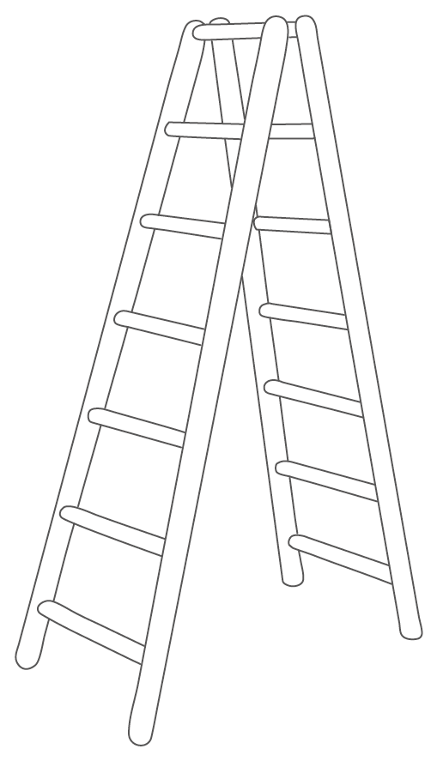
The Ladder of perception
Actions I took
Beliefs I formed
Emotional and physical responses
Logical conclusions I drew
Interpretations and meanings I gave
Value judgements I made
My perception (selected data)
The event (as a camera would capture it)

Slide 14
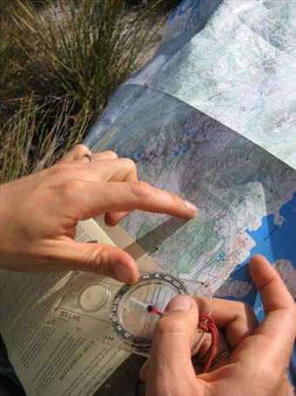
Perception and Connecting with Others
To connect with others, we should try to see their perspective
As a team, we’re all heading in the same direction, but sometimes we carry different maps
Insights Discovery is the common map that we can all share
Insights Discovery is all about adapting and connecting to each other, to exchange useful information, as effectively as possible

Slide 15
Insights Discovery Colour Energies

Slide 16
^{cheerful}
^{challenging}
^{assertive}
^{reflective}
^{concise}
^{caring}
^{enthusiastic}
^{determined}
^{factual}
^{well-argued}
^{reliable}
^{firm}
^{accommodating}
^{objective}
^{fun}
^{active}
^{steady}
^{sensitive}
^{accurate}
^{tactful}
^{driving}
^{constant}
^{structured}
^{harmonious}
^{purposeful}
^{cautious}
^{amenable}
^{strong-willed}
^{convincing}
^{calculating}
^{persuasive}
^{diplomatic}
^{patient}
^{influencing}
^{logical}
^{sociable}
^{outgoing}
^{courageous}
^{forceful}
^{optimistic}
^{co-operative}
^{conventional}
^{mobile}
^{stable}
^{decisive}
^{friendly}
^{consistent}
^{correct}
^{loyal}
^{calm}
^{daring}
^{analytical}
^{engaging}
^{impulsive}
^{realistic}
^{exact}

Slide 17

^{challenging}
^{cheerful}
^{challenging}
^{cheerful}
^{assertive}
^{reflective}
^{assertive}
^{reflective}
^{caring}
^{concise}
^{caring}
^{concise}
^{determined}
^{determined}
^{factual}
^{factual}
^{reliable}
^{enthusiastic}
^{reliable}
^{enthusiastic}
^{well-argued}
^{firm}
^{well-argued}
^{firm}
^{fun}
^{objective}
^{fun}
^{accommodating}
^{objective}
^{accommodating}
^{active}
^{active}
^{steady}
^{steady}
^{sensitive}
^{sensitive}
^{tactful}
^{tactful}
^{structured}
^{accurate}
^{structured}
^{accurate}
^{driving}
^{driving}
^{constant}
^{constant}
^{harmonious}
^{harmonious}
^{cautious}
^{cautious}
^{amenable}
^{purposeful}
^{amenable}
^{purposeful}
^{calculating}
^{strong-willed}
^{calculating}
^{strong-willed}
^{convincing}
^{convincing}
^{diplomatic}
^{persuasive}
^{diplomatic}
^{persuasive}
^{patient}
^{patient}
^{sociable}
^{influencing}
^{sociable}
^{influencing}
^{logical}
^{logical}
^{forceful}
^{courageous}
^{forceful}
^{outgoing}
^{courageous}
^{outgoing}
^{optimistic}
^{co-operative}
^{optimistic}
^{co-operative}
^{conventional}
^{conventional}
^{mobile}
^{mobile}
^{decisive}
^{stable}
^{decisive}
^{stable}
^{consistent}
^{friendly}
^{consistent}
^{friendly}
^{correct}
^{correct}
^{daring}
^{loyal}
^{daring}
^{loyal}
^{calm}
^{calm}
^{analytical}
^{analytical}
^{engaging}
^{engaging}
^{exact}
^{realistic}
^{exact}
^{impulsive}
^{realistic}
^{impulsive}

Slide 18

Finger constantly on the pulse.
Responsible, methodical and works well with facts and figures.
Makes friends quickly and easily.
Sensitive to the needs of the group.
Sets precise goal oriented objectives.
Makes time for people and their problems.
Direct and quick thinking.
Boundless energy, capable of adopting a number of roles simultaneously.

Slide 19

Card Sort
Sort them in to:
Those that relate to you
Those that do not relate to you
Give away those that don’t

Slide 20




The Four Insights Colour Energies
Cool Blue
Showing no bias,
Objective, Detached
Earth Green
Still, Tranquil,
Calming, Soothing
Cheerful, Uplifting,
Spirited, Buoyant
Sunshine Yellow
Fiery Red
Positive, Affirmative,
Bold, Assertive

Slide 21
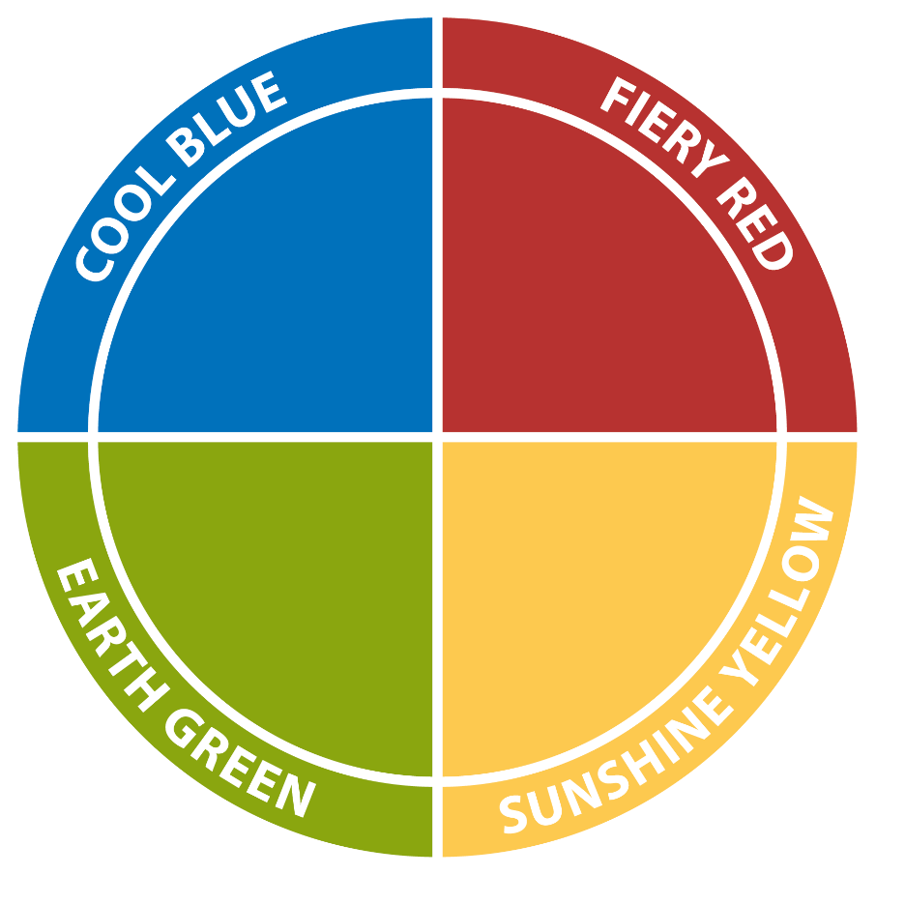
Colour energies on a good day
Reflective
Cautious
Precise
Deliberate
Questioning
Formal
Direct
Competitive
Demanding
Determined
Strong-willed
Action-oriented
Empathetic
Concerned
Supportive
Patient
Relaxed
Caring
Sociable
Dynamic
Demonstrative
Enthusiastic
Persuasive
Informal
Notes:
Describe Fiery Red energy, using the words on the screen and your own definition.
Then ask any participants who wrote down words that were coloured Red in the previous exercise to share them in the chat. This helps to expand the definition of Fiery Red energy.
(Facilitator to have Insights card game with them, and have chosen ahead of time four statements for each colour energy that are a good representation of that colour energy. Read those statements as part of the introduction for each colour energy to help broaden participants’ definitions of the colour energy.)

Slide 22
Colour energies on a bad day
Stuffy
Indecisive
Suspicious
Cold
Reserved
Aggressive
Controlling
Driving
Overbearing
Intolerant
Quietly Resistant
Plodding
Reliant
Stubborn
Defensive
Excitable
Frantic
Indiscreet
Flamboyant
Hasty
Notes:
Explain that all four colour energies are equally positive and bring strengths to an individual and a team. And, all four colour energy strengths can be overextended and turn into weaknesses. Insights calls these the Good Day and Bad Day characteristics of the colour energies.
PRODUCER: 4 Box
Ask participants to type in what they believe each colour energy would look like on a “bad day”.
After participants have given some answers, click to review the words on the slide.
Reiterate that all four colour energies bring equal strengths, and all four can show up in an overextended way as well.

Slide 23
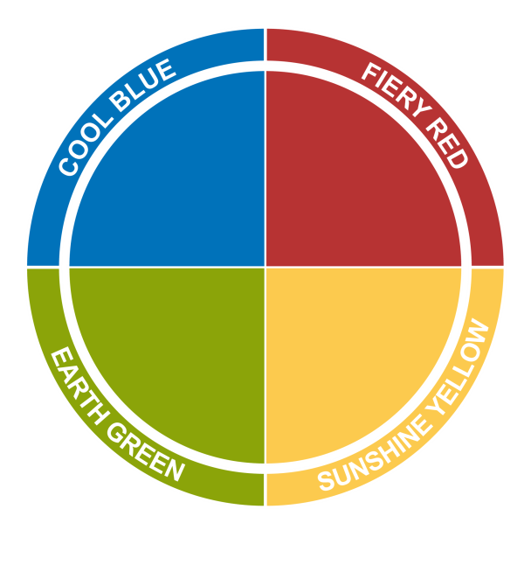
Colour Energy
Exercise

Slide 24

Your Colour Mix
We each have all four colour energies within us.
It is the combination of the four energies that creates the unique YOU.

Slide 25

Your Insights Discovery Personal Profile

Slide 26
The Jungian Preferences
Dr. Carl Jung was a Swiss doctor and one of the 20th century’s greatest psychologists. He was interested in our nature, specifically:
How we are oriented to our environment
How we make decisions
How we interpret information

Slide 27
Jungian Preferences and the Colour Energies
Your ‘Attitude’
Introversion
Quiet
Observant
Inwardly focused
Depth focused
Intimate
Reserved
Reflective
Thoughtful
Cautious
Extraversion
Talkative
Involved
Outwardly focused
Breadth focused
Gregarious
Flamboyant
Action oriented
Outspoken
Bold

Slide 28
Jungian Preferences and the Colour Energies
Your ‘Decision Making’ Functions
Thinking
Formal
Impersonal
Analytical
Detached
Objective
Strong-minded
Competitive
Particular
Task focused
Feeling
Informal
Personal
Illogical
Involved
Subjective
Flexible
Accommodating
Ambivalent
Relationship focused

Slide 29
When you see the next slide, write down what is there for you.

Slide 30
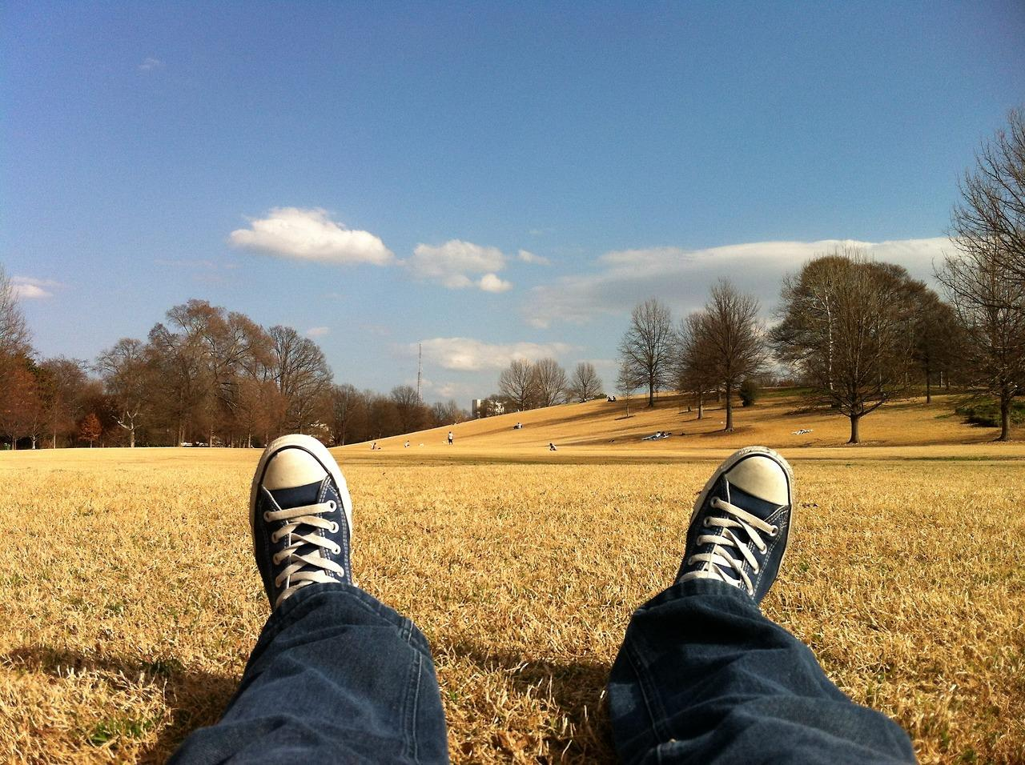

Slide 31
Jungian Preferences and the Colour Energies
Your ‘Perceiving’ Functions
Sensation
Specific
Present-oriented
Realistic
Consistent
Down-to-earth
Practical
Precise
Factual
Step-by-step
Intuition
Global
Future-oriented
Imaginative
Unpredictable
Blue-sky
Conceptual
General
Abstract
Spontaneous

Slide 32
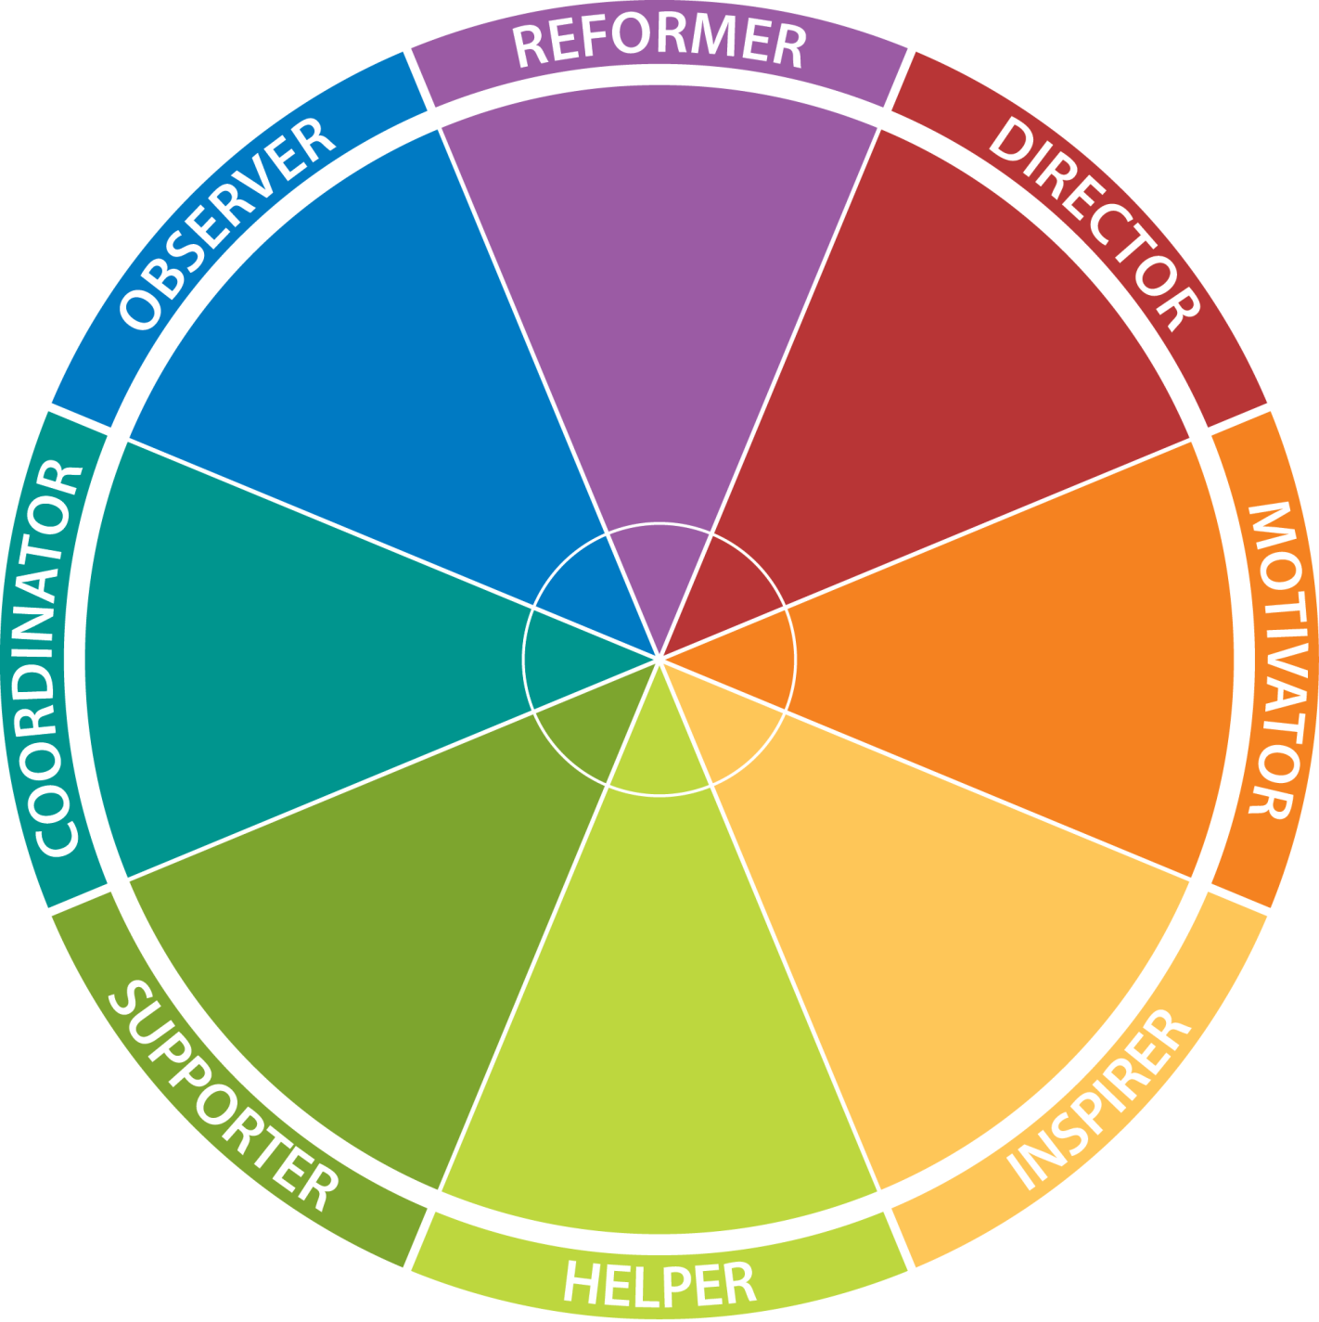
The Eight Types
Notes:
Standard slide
Explain the full model as 72 type wheel

Slide 33
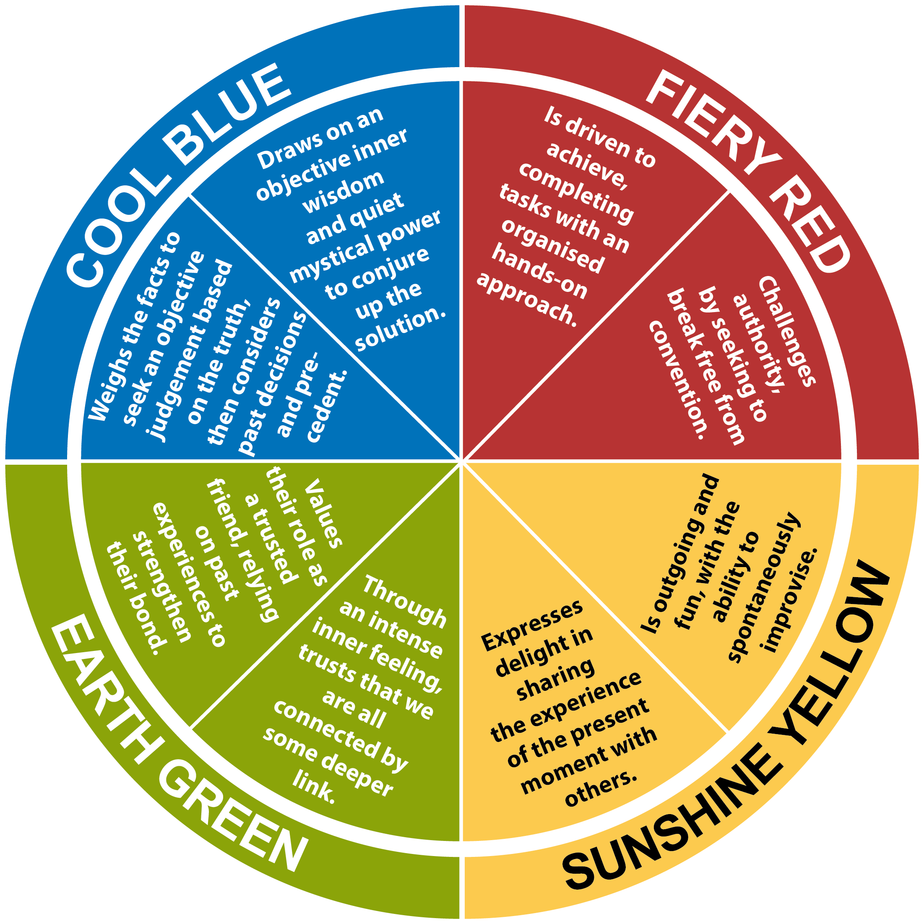
A combination of Fiery Red with Sensation
A combination of Cool Blue with Intuition
Sensation and Intuition
in every colour energy
A combination of Earth Green with Sensation
A combination of Sunshine Yellow with Intuition
A combination of Cool Blue with Sensation
A combination of Fiery Red with Intuition
A combination of Sunshine Yellow with Sensation
A combination of Earth Green with Intuition
Notes:
Animated slide showing where Sensation and intuition show up

Slide 34
Your Insights Discovery Personal Profile

Slide 35
Insights Discovery Personal Profile
Foundation Chapter (Always Required)
Management Chapter
Effective Selling Chapter
Personal Achievement Chapter
Interview Chapter
The Insights Wheel & Colour Graph Dynamics
Notes:
Some Tips
Emphasize Strengths
Emphasize Uniqueness – no two reports are the same
Encourage recipients to share their profile

Slide 36


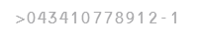
Graph I – Conscious Persona
More prepared self; your intentional self
Like a selfie photograph of you
Graph II – Less Conscious Persona
More instinctive self
Shows up when relaxed or under stress
Like a candid photograph
Notes:
Explain the Conscious and Less Conscious Personas and Graphs
Your Conscious Graph is the one on the LEFT– this graph shows the color preferences of you CONSCIOUS PERSONA
Your CP is the self that consciously prepares to interact with the world
This is my intentional self
Similar to a Portrait photo
The graph on the right shows the preferences of your LESS CONSCIOUS PERSONA
This is your more instinctual self – the unprepared…more habitual self
Your LC Persona may express itself to others more when you are more relaxed/comfortable or when under stress!
Unlike a Portrait – your LC is more like a Candid shot

Slide 37
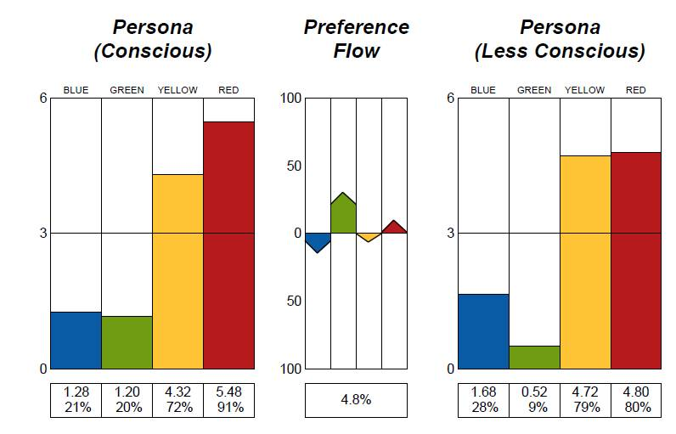
The indirect responses to the evaluator
Suggests your more instinctive behaviour
Highlights possible blind spots
How you might “REACT”
The direct responses to the evaluator
Your intentional self. Combines who you want to be, who you need to be, and who you believe others want you to be
How you might “ACT”
Measures energy flow from Less Conscious to Conscious Graph
Highlights which colour energy you are putting effort into or suppressing
Notes:
Let’s look at these a bit closer…
Each graph shows a 6 point scale with 3 as midline – correlate with the Most like me/Least like me
**Energies above the midline we’d say are energies of inclined usage – will be more visible – more easily accessed
CP Graph: Direct response to evaluator
Who I am, want to be, need to be
My ACT self
LC Graph Reflects what we say we are not…
More instinctive behavior
Our REACT self
Preference Flow:
Shows energy differentials from LC to C
Shows energies we are dialing up or down to meet needs of our circumstances
May be up or down, may be slight, may be strong
Ask yourself is “What is my preference flow telling me?” You tell the story!
Any Questions?

Slide 38
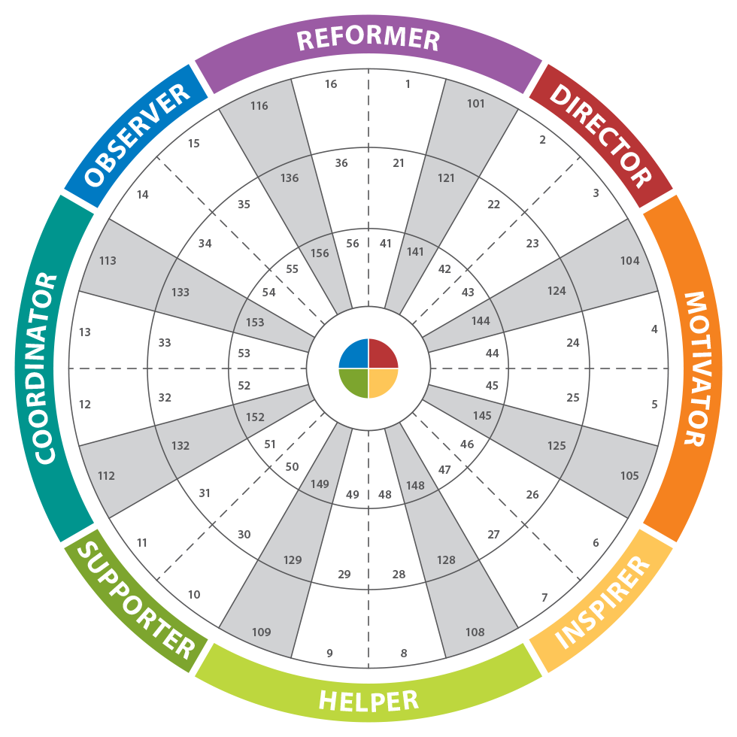
Insights Discovery 72-Type Wheel
No position on the wheel is better than any other
Each position offers unique gifts and strengths
Every position on the wheel is capable of adapting and connecting
Notes:
Standard slide
Explain the full model as 72 type wheel

Slide 39
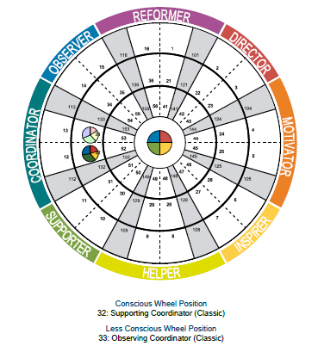
Insights Discovery Wheel Position
Your wheel position is determined by:
The order of your color energies
How many colors are above the mid-line
Notes:
Explain how a wheel position is determined

Slide 40
Insights Discovery Wheel Position
Creative Type
Less Conscious Persona Graph
Wheel Position
Conscious Persona Graph
Wheel Position
The Name of Your 8-Type
Notes:
Explain what the Wheel page in the profile means and what they are looking for

Slide 41
Insights Discovery Wheel Position
Focused
Classic
Accommodating
Notes:
Explain the numbering and the rings

Slide 42
Your Profile
Read through the Profile
Take a look at the graphs
Suggested Process:
Highlight the statements that you believe are highly accurate or relevant for you
Place ?? next to statements that you don’t agree with

Slide 43
Insights Discovery Colour Energies
Who
am
I?

Slide 44
Your Positions on the Wheel
Notes:
Add team wheel

Slide 45
Your Colour Mix
Notes:
Add pie charts

Slide 46
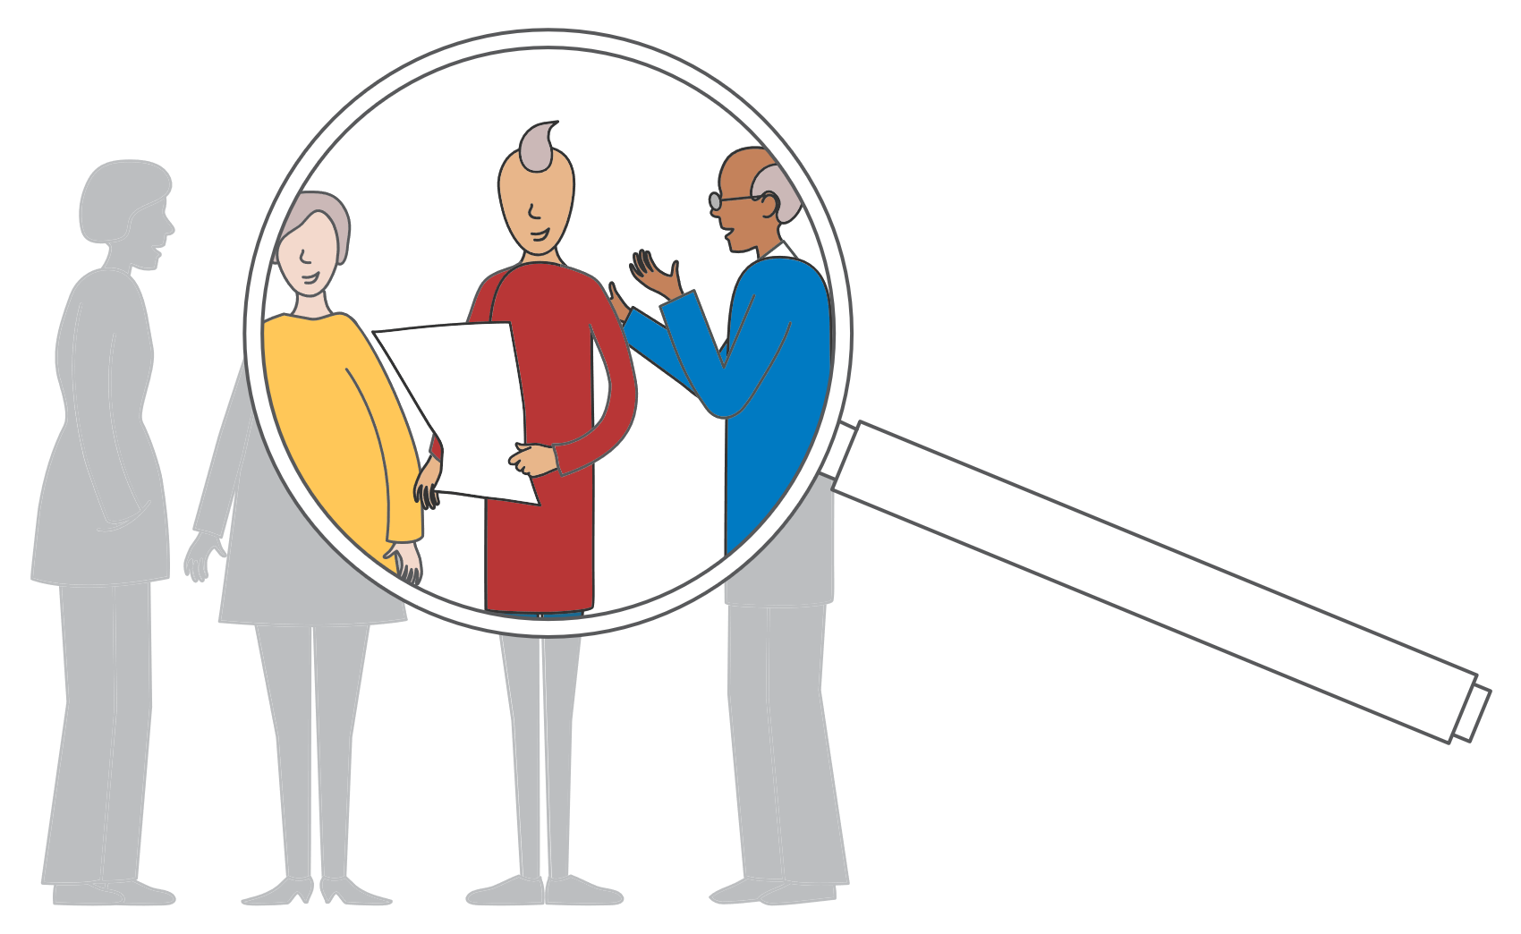
Recognising types
Every time you meet someone, you have the opportunity to practise your skill of recognising and adapting to their colour energies.

Slide 47
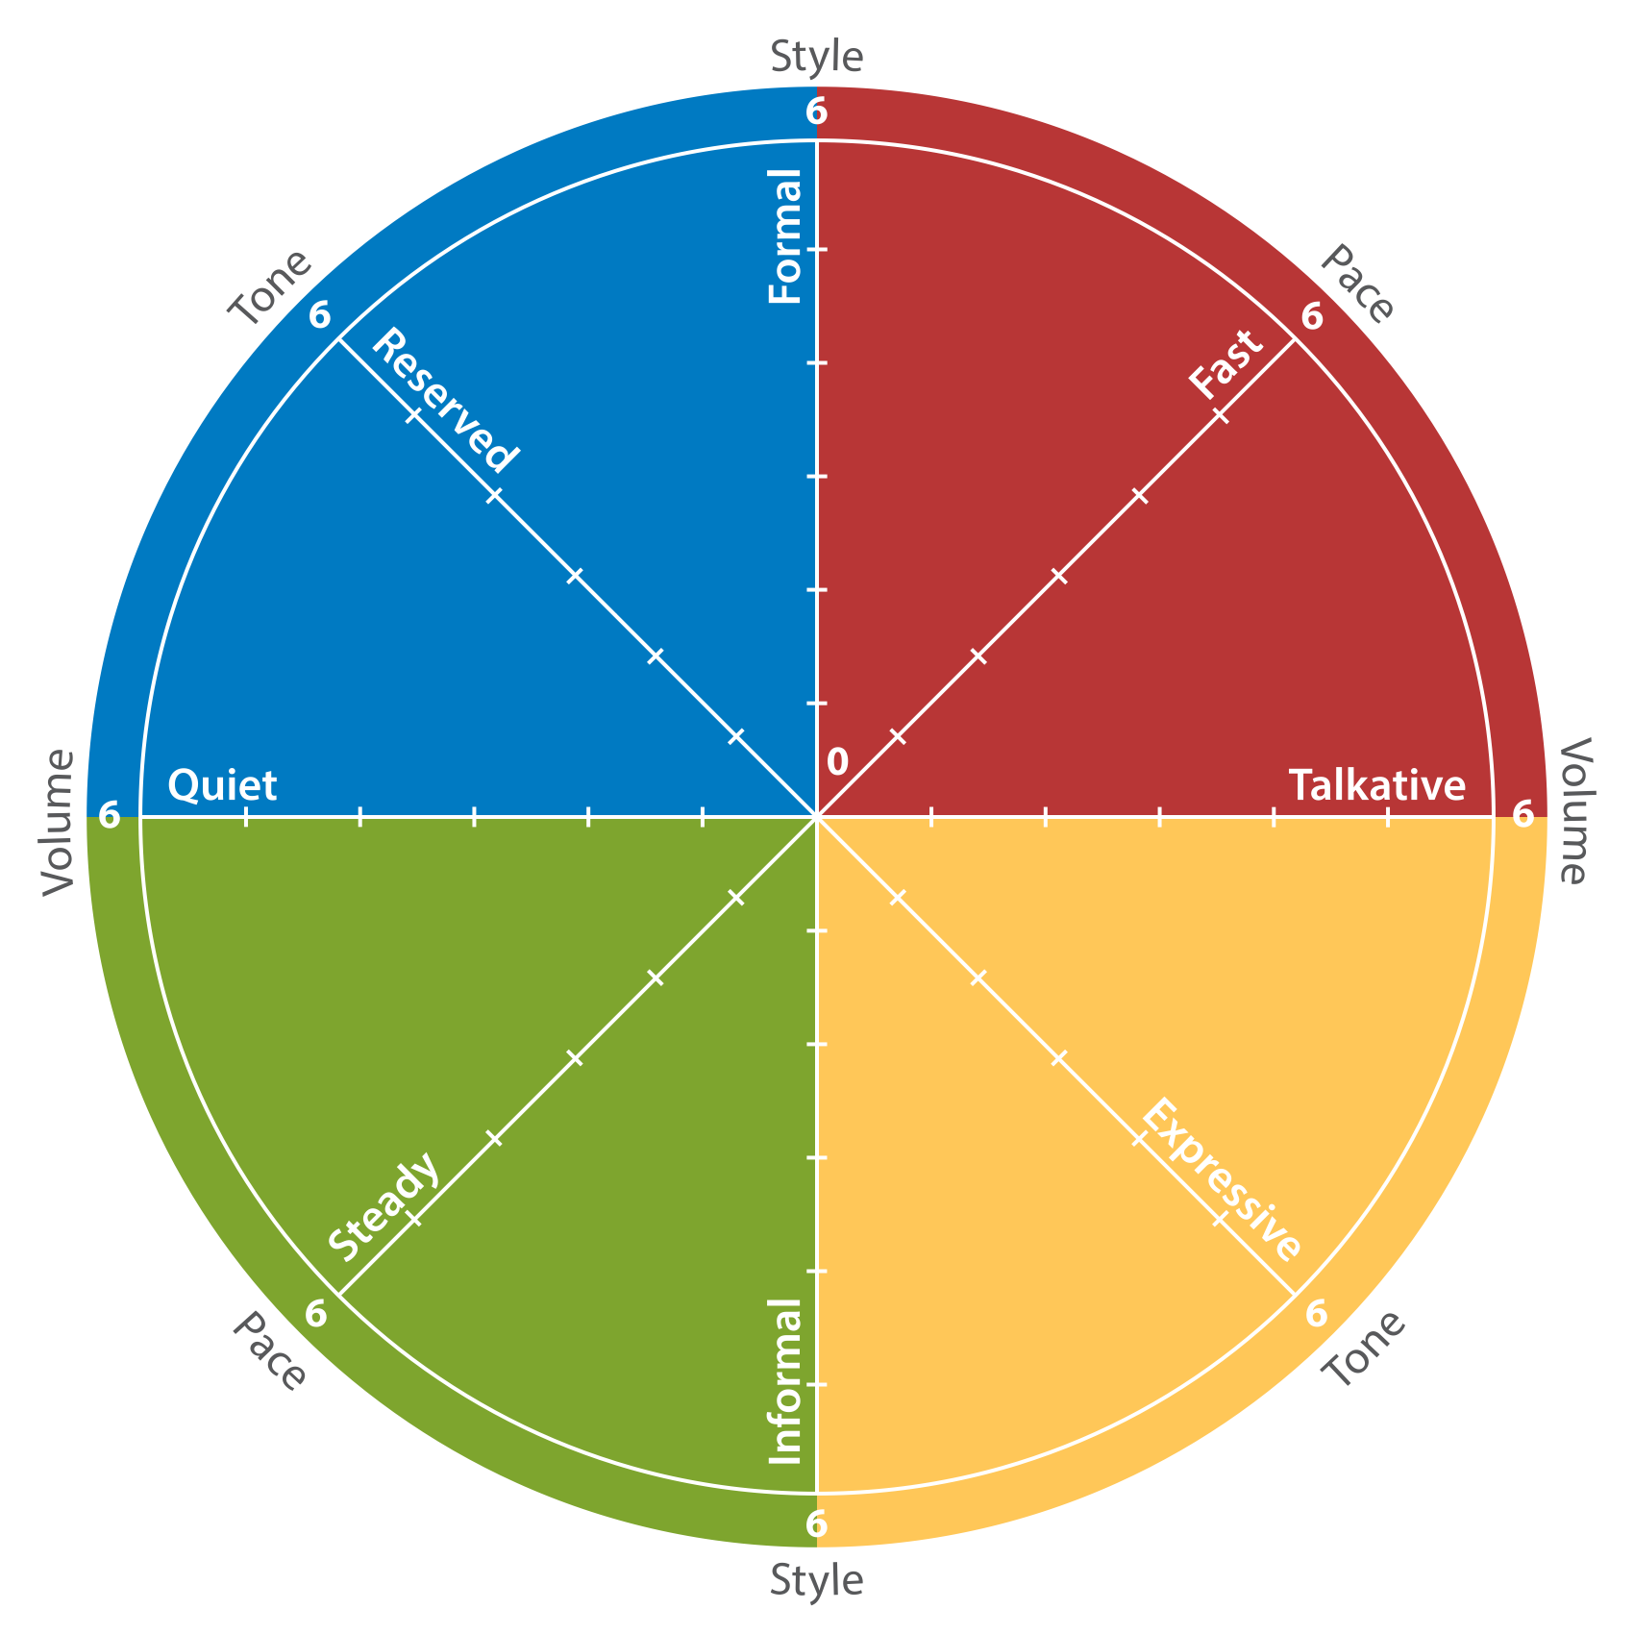
Verbal style

Slide 48
Body language
What colour energy clues do you observe?

Slide 49

Clues from Body Language
Cool Blue
Detached
Limited physical contact
Still - Body more rigid
Little facial expression
Fiery Red
Formal
Direct eye contact
Firm handshake
Upright posture
Earth Green
Warm smile
Some eye-contact
Gentle handshake
Few gestures
Sunshine Yellow
Relaxed
Open and responsive
Lots of facial expression
Physical contact

Slide 50
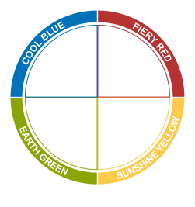
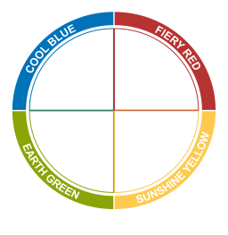

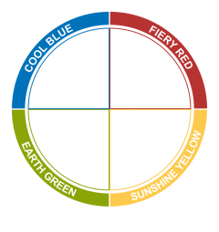
Recognizing Type Review
Someone shows a:
Reflective quiet style
Outgoing and talkative
Strong focus on results
Natural focus on relationship
Introversion
Extraversion
Thinking
Feeling

Slide 51
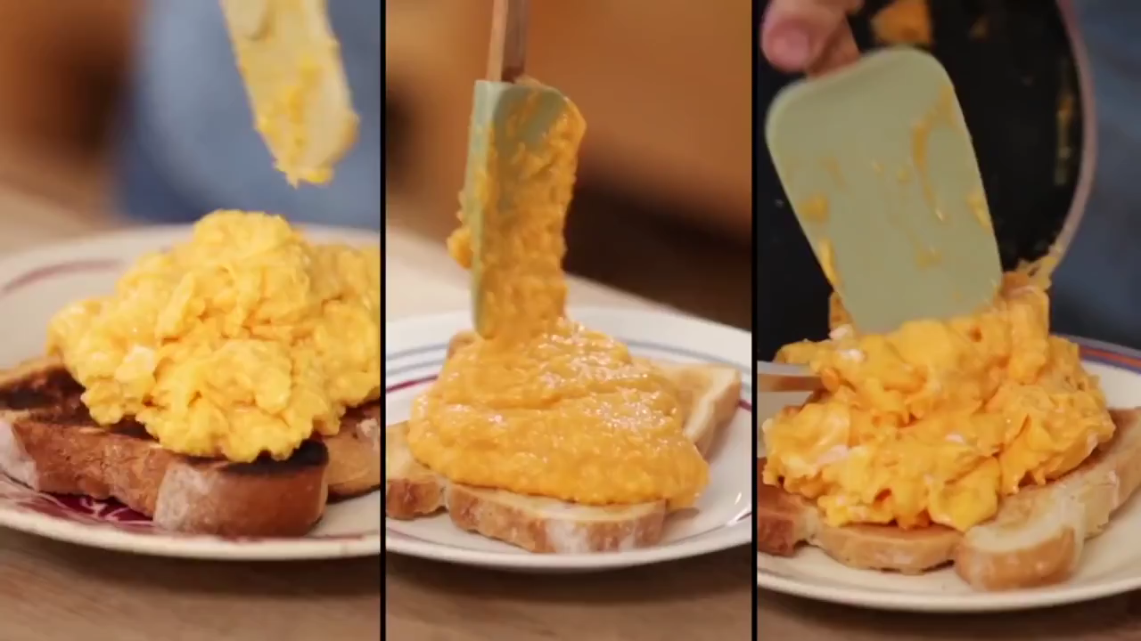
Notes:
What first video and get them to assess where they would place Jamie on the wheel.
He shows a lot of yellow green energy

Slide 52

Notes:
Show the video of Gordon, once done ask group to place him on the wheel.
He shows a lot of Red but there is also a lot of Yellow

Slide 53

Notes:
Show final video and ask group to place Heston on wheel.
He shows a lot of blue energy

Slide 54
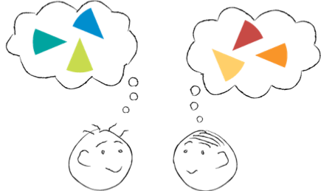
Interacting With Others

Slide 55
Fiery Red
Do
Be direct and to the point
Focus on results and objectives
Be brief, be bright and be gone
Don’t
Hesitate or waffle
Focus on feelings
Try to take over

Slide 56
Sunshine Yellow
Do
Be friendly and sociable
Be entertaining and stimulating
Be open and flexible
Don’t
Bore them with details
Tie them down with routine
Ask them to do things alone

Slide 57
Earth Green
Do
Be patient and supportive
Slow down to their pace
Ask their opinion; give time to answer
Don’t
Take advantage of their good nature
Push them to make quick decisions
Spring last minute surprises

Slide 58
Cool Blue
Do
Be well prepared and thorough
Put important things in writing
Let them consider all the details
Don’t
Invade their personal space
Be flippant on important issues
Change their routine without notice

Slide 59
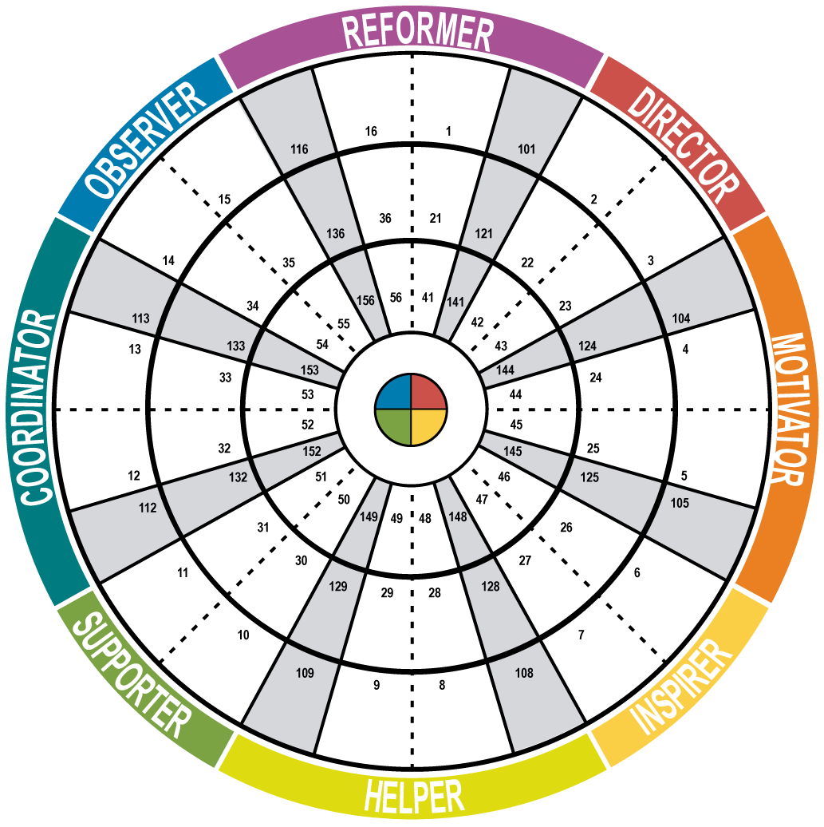
Self
Plot your own position on the wheel and the positions of some people you interact with
Oliver
David
Chris
Margaret
Scott
Helen
Iain
R
D
O
C
M
H
S
I
Notes:
Animated slide showing how to plot people on the wheel.

Slide 60
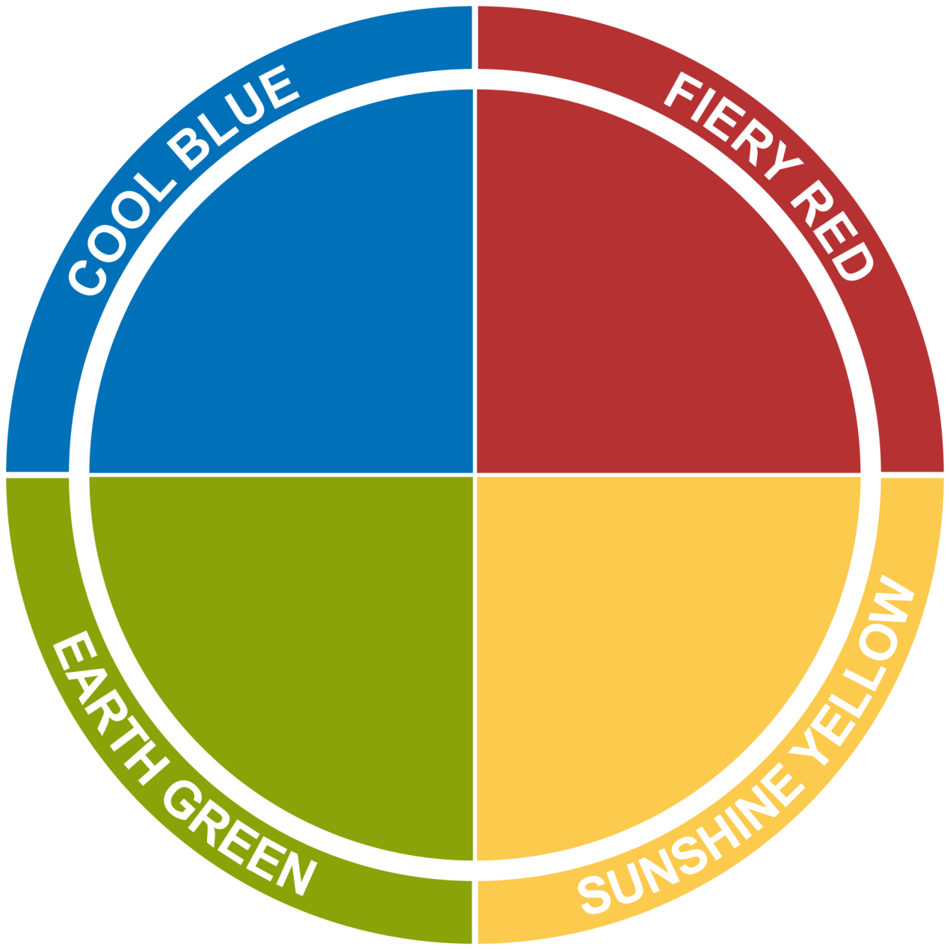
Colourful Statements
Let’s do
it RIGHT
Let’s do
it NOW
Analytical
Precise
Cautious
Detail-oriented
Formal
Let’s do it
WITH CARE
Let’s do it
TOGETHER
Collaborative
Encouraging
Mentoring
Patient
Relaxed
Sociable
Dynamic
Demonstrative
Enthusiastic
Persuasive

Slide 61
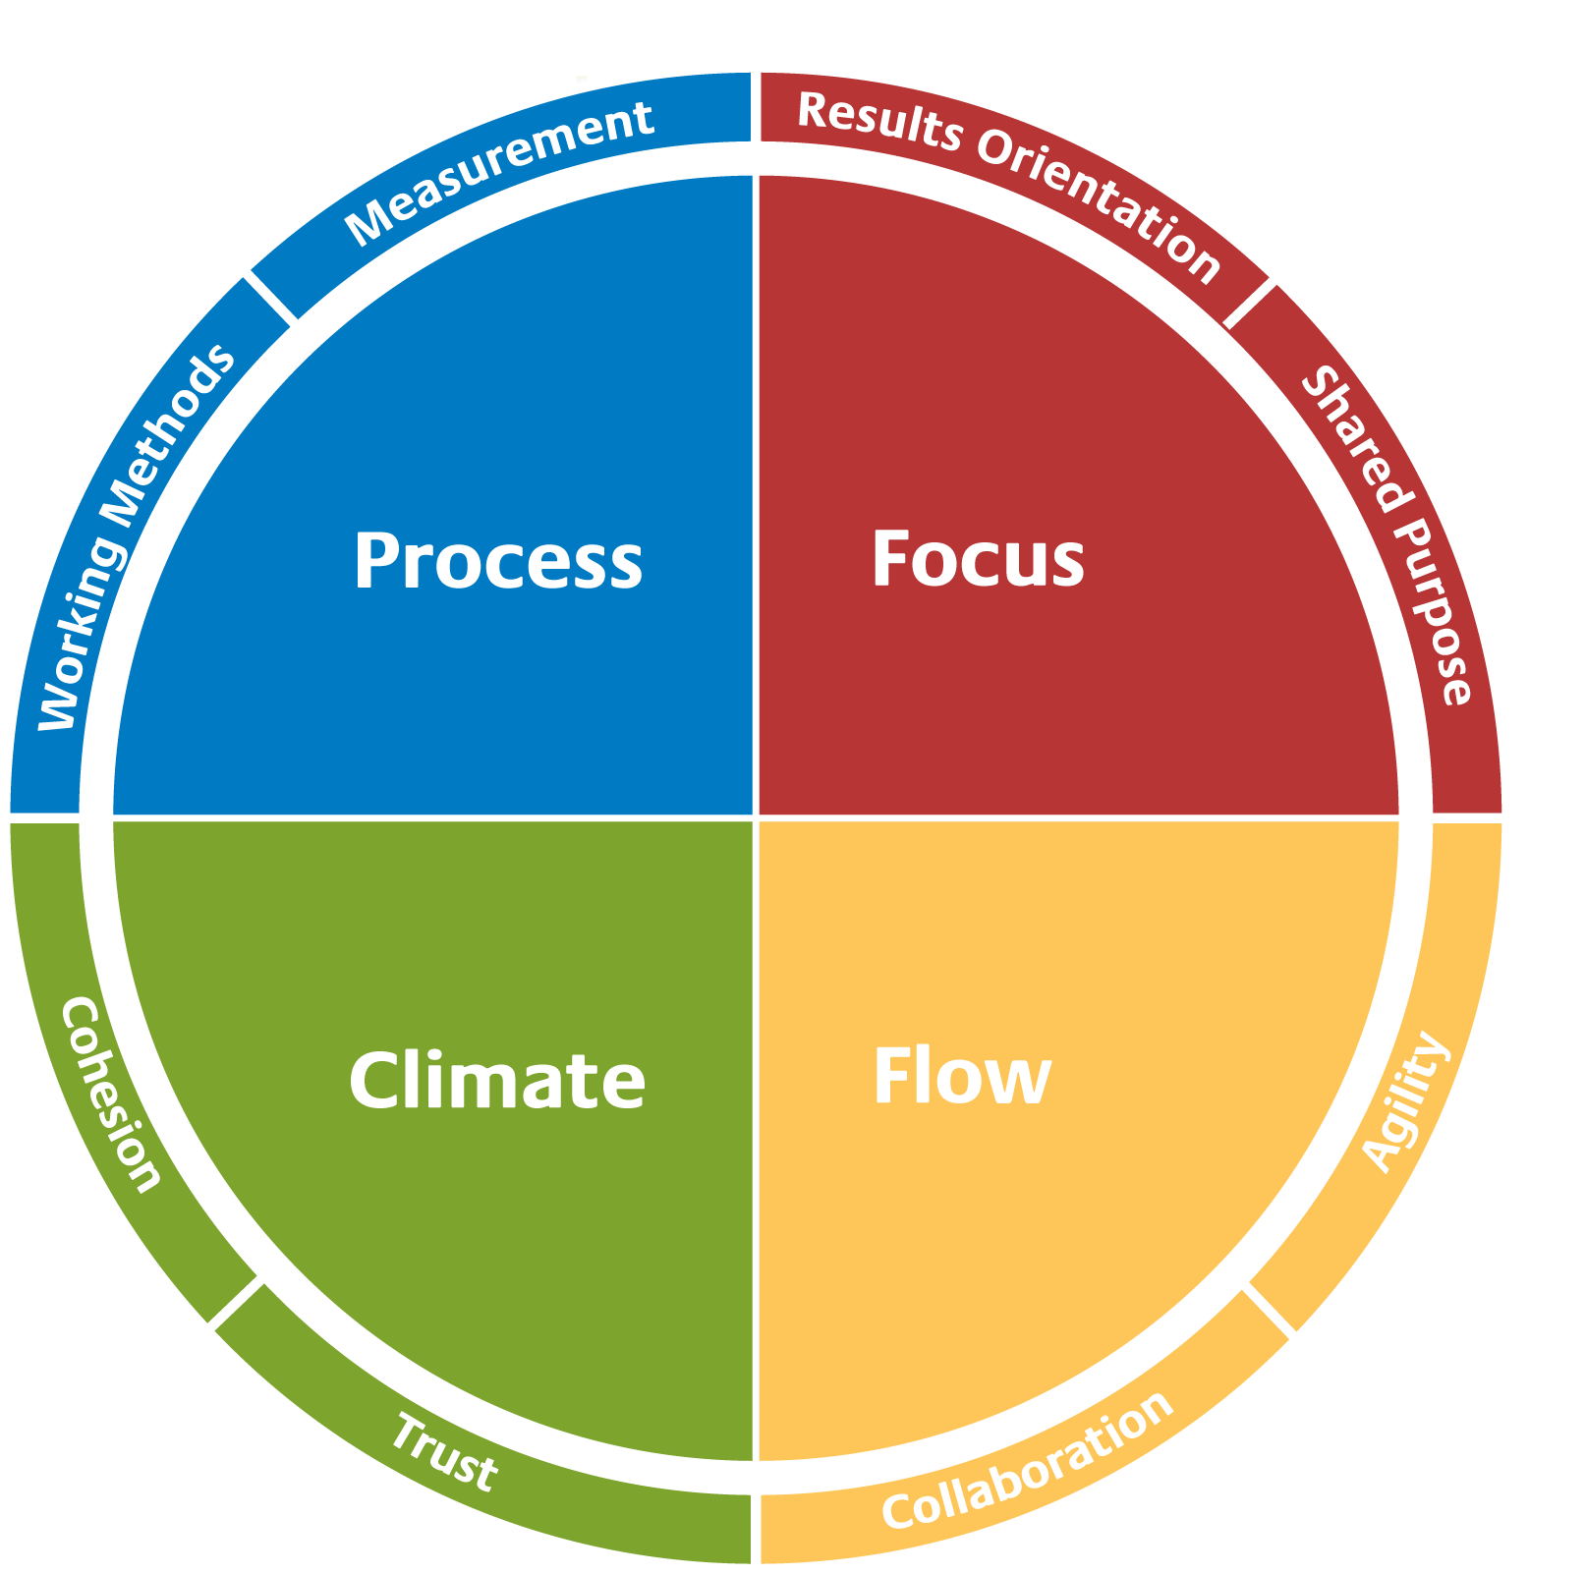
Team Effectiveness Model

Slide 62
Insights Discovery Colour Energies
The value
I bring
to the Team

Slide 63

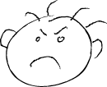

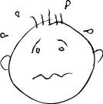

Your Value to the Team
On a good day
On a bad day
Likes
Goals
Fears
Assertive
Sociable
Encouraging
Forceful
Unreliable
Stubborn
Adventure
Interaction
Being of service
Success
Prestige
Popularity
Losing control
Rejection
Time pressure

Slide 64
Insights Discovery Colour Energies
You now have the opportunity to create a Team A to Z
You have 20 minutes
Be as creative as possible, your Team A to Z should include:
Information about team members,
Personal stories,
Things their report says, and
Objects.
Team
A to Z

Slide 65
Insights Discovery Colour Energies
Your Team
Charter

Slide 66
After this workshop…
Take some extra time to read your profile again.
Share your profile with some colleagues, friends or family.
Arrange a time to speak to colleagues and share some information about yourself, the value you bring to the team and the support you may need.
Take action on adapting your style to others around you.
Let’s do
it RIGHT
Let’s do
it NOW
Analytical
Precise
Cautious
Detail-oriented
Formal
Let’s do it
WITH CARE
Let’s do it
TOGETHER
Collaborative
Encouraging
Mentoring
Patient
Relaxed
Sociable
Dynamic
Demonstrative
Enthusiastic
Persuasive

Slide 67
Thank you!
Notes:
This slide can be used for a call to action.

